Slide 1
PHARMACY STORE MANAGEMENT SYSTEM

Slide 2
PROBLEM STATEMENT:
A PHARMACY STORE HAS TO HANDLE RECORDS FOR VARIOUS MEDICINES AND HAVE TO MAINTAIN A RECORD OF HIS CUSTOMER SUPPLIERS AND EMPLOYEES. HENCE NEED TO MAKE A COMPUTER BASED PHARMACY MANAGEMENT SYSTEM USING JAVA AND MYSQL(DATABASE)

Slide 3
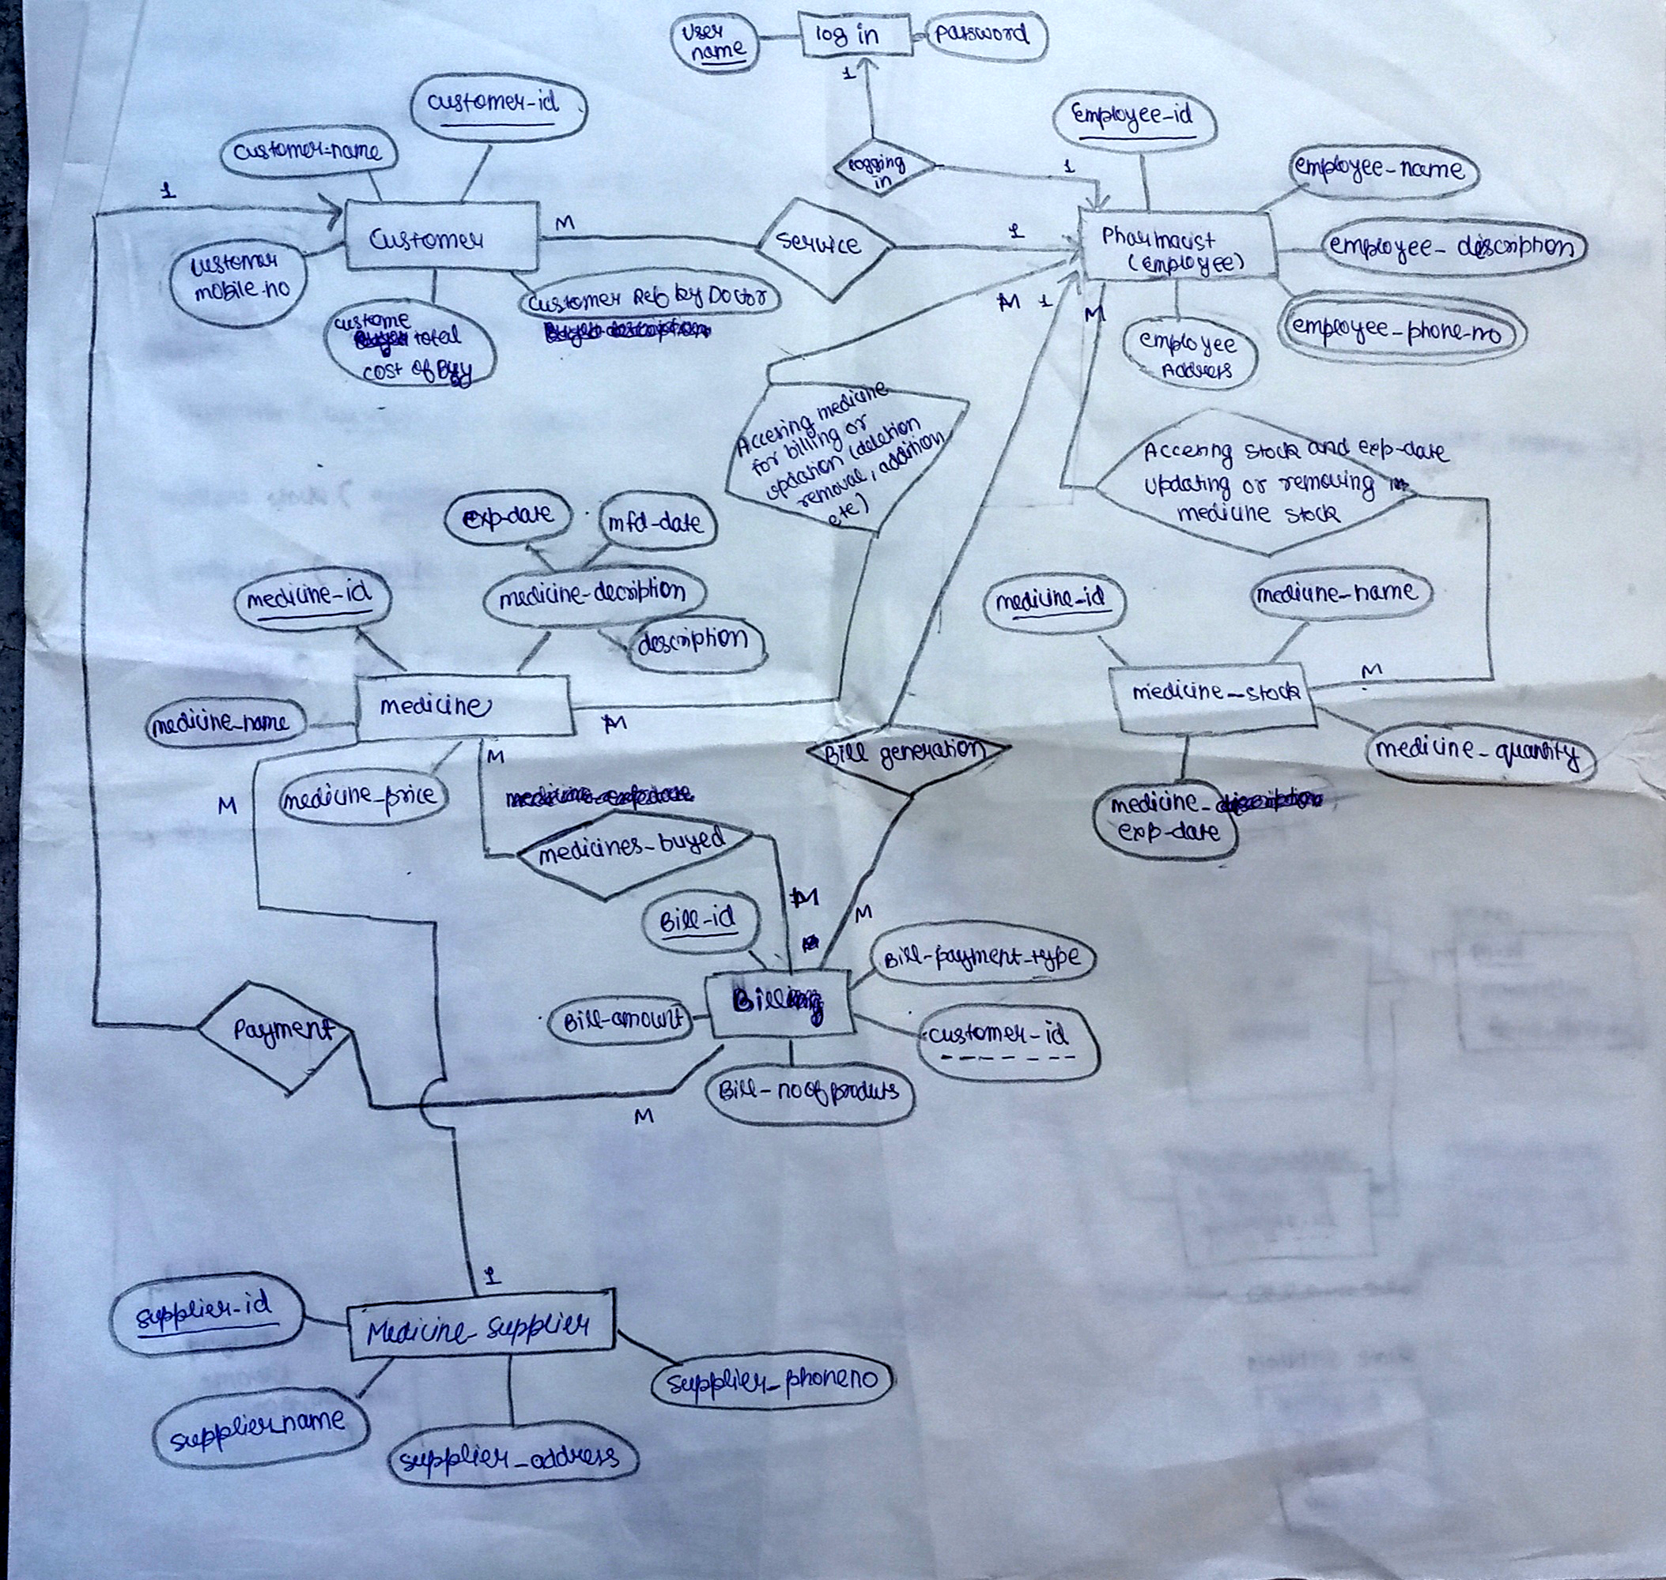
ER-DIAGRAM:

Slide 4
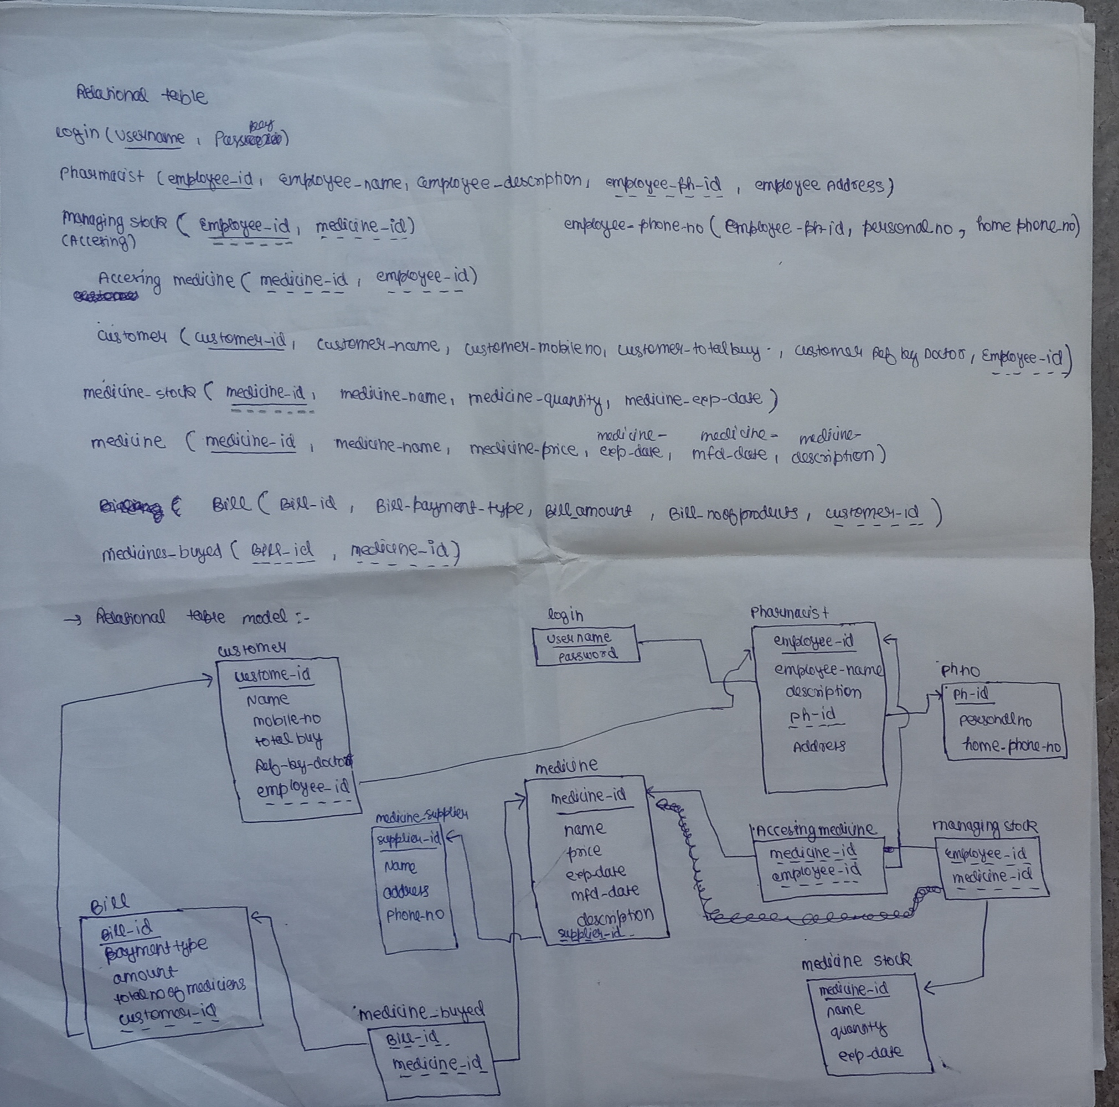
RELATIONAL–TABLE:

